Slide 1
Reservation System
B10715037 張家菁
B10715053 吳政杰 B10715016 梁欣童
B10730033 宋旻芸

Slide 2
Roles and responsibilities
of the team
Team Leader - 張家菁
Program Manager
Chief engineer
Designer
Program consultant
Main host in meetings
Integrate work content

Slide 3
Roles and responsibilities
of the team
Team Member - 吳政杰
Creative Director
Testing engineer
Designer
Document writer
Drawing Expert
Presentation video maker

Slide 4
Roles and responsibilities
of the team
Team Member - 梁欣童
Chief Editor
Testing engineer
Document writer
Designer
Presentation video maker
Artistic Director

Slide 5
Roles and responsibilities
of the team
Team Member - 宋旻芸
Chief Translator
Testing engineer
Designer
Presentation video maker
Document writer
Drawing Expert

Slide 6
What is our
system about ?
Provided to
Companies
Administrative agencies
Schools
Able to reserve rooms in advance
Convenient
Avoid dilemma that all rooms are full
Clear interface

Slide 7
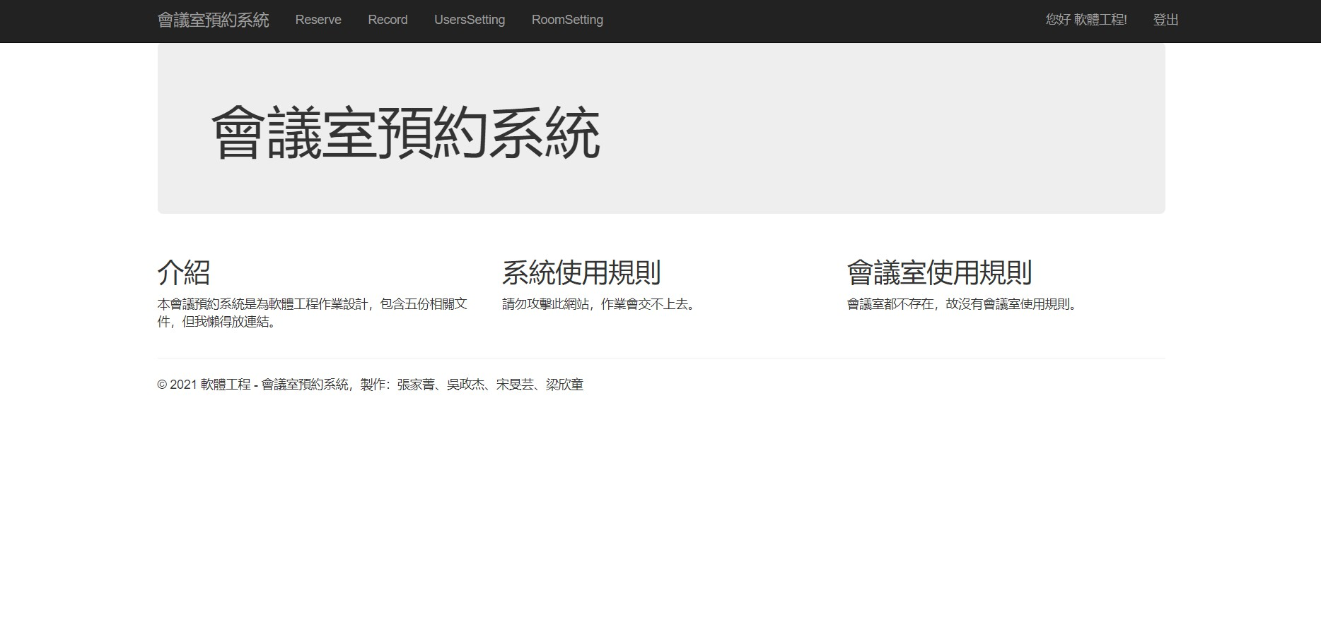
User Interfaces
We will teach you how to use the system in the Presentation video, also, you can see the steps in our user guide.
The following is our Home page.

Slide 8
Functional
Requirements
We use some Use case to illustrate functional requirements.
User login
Log out
User reserve conference room
User views reserving record
User cancels room reservation
Manager edits the room's settings
Manager edits user's authority settings
Manager views individual user's room reservation record

Slide 9
Non-Functional
Requirements
The backup of database
Security
Reliability
Performance Requirements
Safety Requirements

